Slide 1


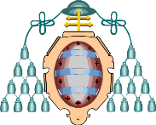

Using widgets to monitor the LHC experiments
I. González Caballero (U. Oviedo, Spain)
S. Sarkar (SNS, Pisa, Italy)
Taipei (Taiwan) – October 2010

Slide 2







Disclaimer…
During this presentations several popular commercial companies and services will be mentioned. We are not affiliated by any means with any of them.

Slide 3
…and some remarks
We developed our experience with widgets in the context of the computing tasks at the CMS collaboration
  …but we believe this work can be extrapolated to many other environments
While we have made an effort to show examples for every widget platform supported, we have no easy access to some of them and therefore you might not see how our work looks like there
  Just try and let us know!
This presentation will be mostly devoted to why widgets are a good idea to monitor stuff, how they can be built and some examples
  For a comprehensive list of widgets developed in the CMS environment, please refer to the documentation

Slide 4
Monitoring the world…
The data useful for monitoring is usually scattered over several databases, web pages (central or local) and systems
  A myriad of more or less complex web pages provide access to (usually) project related plots and numbers
Users, experiment supervisors, service operators and system administrators are interested in different types of information
  Different operators need to monitor different data from, sometimes, the same sources
  Responsibilities are split in different ways at different places or may change over time
People looking after something (site, service,…) know better the strong and weak points
  They would like to focus their monitoring efforts on those aspects that are unstable or more prone to failure

Slide 5
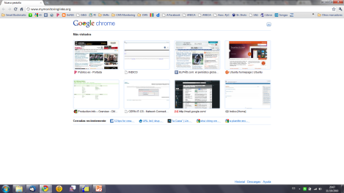
Monitoring solution 0 (or even -1)
Scanning recursively through a set of web pages
  Not very practical
  Click! Click! Click!…
  … even if you keep all the links together in another web page
  … even if you manage to have all the links up to date
  …
Monitoring XYZ
URL 1
URL 2
…
URL N (N→∞)

Slide 6
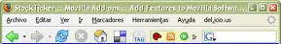
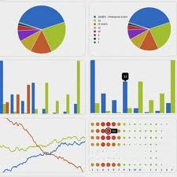
Monitoring solution 1: Customized web
Fortunately most systems can be thought also as web services providing monitoring data through a more or less simple API
Personal/Institutional monitoring web pages aggregating these data can be built easily based on that
  Each individual needs to build its own HTML file
  API changes (they happen!) means all individuals have to change their HTML files
  Each «user» needs to master HTML (and possibly Javascript)

Slide 7
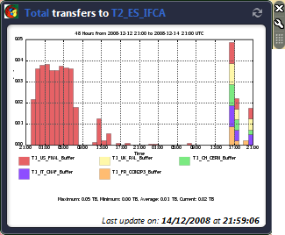
Monitoring solution 2: Widgets
Fortunately most systems can be thought also as web services providing monitoring data through a more or less simple API
Web widget (Wikipedia): It's a small application that can be installed and executed within a web page by an end user... Other terms used to describe web widgets include: gadget, badge, module, webjit, capsule, snippet, mini and flake.
Provide a set of more or less general customizable widgets that can be aggregated to form private or public monitoring web pages
  Widgets are single, although not necessarily simple, units of information (monitoring data, for example) …
  … that can also be built on top of those web services…
  … that users can select and aggregate to (at least one of) the platforms in the market: Netvibes, iGoogle, Apple DB, etc…
  … knowing that if some API or service is modified, the fixes propagates automatically to them

Slide 8
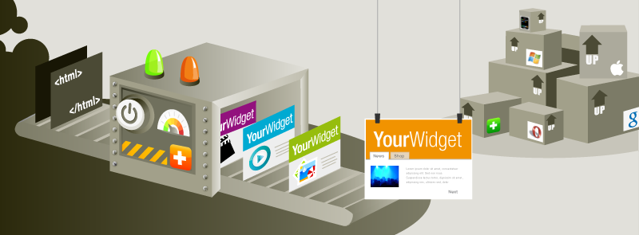
Universal Widget API (UWA)
It is a widget Application Programming Interface developed by well known web portal Netvibes
Widgets developed using UWA are compatible with the main widget platforms out there:
  It may also be easily added to any web page (i.e. blogs)
  Users may use the platform they like most or feel more comfortable with
Supports modern web technologies (AJAX)
  A typical widget is only a bit of (X)HTML and JavaScript
The API and part of the server technologies behind are released as Open Source through:
http://www.netvibes.org
Notes:
Currently closed for new developments to come

Slide 9
Pros and Cons of UWA
Pros
Cons
Single development valid on many platforms
  No specific widget platform is imposed on the users/admins/operators
Open Source
  Customization possible at many different levels
  Including forking the project
Great set of web tools:
  Ecosystem: to expose widgets
  Localization supported
  Developers documentation and fora
Many complementary utility widgets available:
  (Multi) RSS feeds, automatic parser, the usual clocks, calendars, …
Answers to technical questions and support a bit slow
No current way to provide a simple URL where a widget with a given set of values for the options can be downloaded or installed
  May be done by installing and hacking a server
Still no support for modular programming
  Each widget file (html) must have all the code it uses
  No “includes” are allowed
  Support for this very important use case in the long term requested
Authentication through certificates might be not supported
  Some web services require it!

Slide 10
UWA widget basic structure
XHTML Headers
A UWA widget is an XHTML file with
  Some HTML
  Some CSS
  Some JavaScript
  A few XML fields used for the preferences
There are three main blocks in a UWA widget
  A set of standard XHTML Headers
  The core of the widget where the behavior is defined
  The HTML skeleton of the widget
<head />
<body />
http://dev.netvibes.com/doc/uwa/documentation/anatomy_of_a_uwa_widget

Slide 11
UWA widget base structure - Headers
XHTML Headers
<?xml version="1.0" encoding="utf-8"?>
<!DOCTYPE html PUBLIC "-//W3C//DTD XHTML 1.0 Strict//EN" "http://www.w3.org/TR/xhtml1/DTD/xhtml1-strict.dtd">
<html xmlns="http://www.w3.org/1999/xhtml"
xmlns:widget="http://www.netvibes.com/ns/">
<head />
<body />
Standar headers
  The widgets should use the utf-8 encoding

Slide 12
UWA widget base structure - <head/>
XHTML Headers
<head />
Meta Information
Preferences
Styles
Behaviour (JavaScript)
<body />

Slide 13
UWA widget base structure - <head/>
XHTML Headers
<meta name="author" content="IGC"/>
<meta name="description“
content="Hello world"/>
<meta name="website"
content="http://example.com/bla"/>
<meta name="version" content="1.1"/>
<meta name="keywords“
content="CHEP2010, widgets, example"/>
<meta name="thumbnail“
content="http://example.com/bla.gif"/>
<meta name="apiVersion" content="1.0"/>
<meta name="debugMode" content="false"/>
<head />
Meta Information
Preferences
Styles
Behaviour (JavaScript)
<body />
Small description of the widget
  Author, thumbnail, keywords…

Slide 14
UWA widget base structure - <head/>
XHTML Headers
<widget:preferences>
<preference name="thename" type="text" label="Name" defaultValue="unknown"/>
<preference name="service" type="list" label="Service" defaultValue="CE">
<option value="CE" label="CE"/>
<option value="SRM" label="SRM"/>
</preference>
…
</widget:preferences>
<head />
Meta Information
Preferences
Styles
Behaviour (JavaScript)
Defines how the users interact with the widget
Possible options include checkboxes, list boxes, text fields, passwords…
<body />

Slide 15
UWA widget base structure - <head/>
XHTML Headers
<style type="text/css">
a:hover, a:active, a:visited {
text-decoration: none;
border: none;
}
</style>
<head />
Meta Information
Preferences
Styles
Behaviour (JavaScript)
CSS styling syntax
  Not mandatory: One can use the usual HTML code to style the widget elements
  …but it is a good coding practice
<body />

Slide 16
UWA widget base structure - <head/>
XHTML Headers
<script type="text/javascript">
widget.onLoad = function(){
var name = widget.getValue("thename");
widget.setBody("Hello" + name);
}
</script>
<head />
Meta Information
Preferences
Styles
Behaviour (JavaScript)
Use JavaScript to:
  Find out the preferences
  Find the information from the web services in JSON, XML, HTML or plain text formats
  Build the final information and present it to the users
  May interact with the DOM in the <body/> part
<body />

Slide 17
UWA widget base structure - <body/>
XHTML Headers
<body>
<p>This widget is an example for
<a href="http://event.twgrid.org/chep2010/">
CHEP 2010
</a>
</p>
<p>Loading...</p>
</body>
<head />
<body />
Defines the HTML skeleton for the widget
The JavaScript can interact with the elements in this section

Slide 18
Improvements in the widgets
We have extended some of our widgets by adding extra functionality to them:
  Versioning support
  Debug information
  Standard date format for the footer
Still not used in all our widgets
  We have to use cut & paste since there is no modular support in UWA yet
  A kind pre-compiler may help adopting it

Slide 19
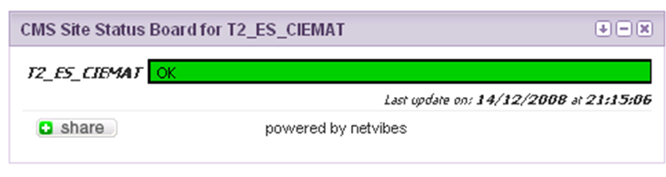


Example widgets: Site Monitoring
- Site Status Board -
Shows the status of the Site according to the Site Status Board metrics defined in CMS
http://eco.netvibes.com/widgets/296601/cms-site-status-board
- SAM Tests -
Available LCG and CREAM CE, SRM & SRMv2
Information on particular tests and overall status
  From the Dashboard
http://eco.netvibes.com/widgets/233892/cms-site-availability-monitoring-sam

Slide 20
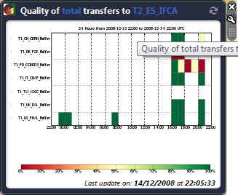
Example widgets: Data Transfers
- Transfer Rate/Volume or Transfer Quality -
Direction: Up/Down link
Instance: Prod, Debug, Dev, All
Period shown: Last day, week, month…
Transfers: http://eco.netvibes.com/widgets/206202/phedex-transfer-monitoring
Quality: http://eco.netvibes.com/widgets/206702/phedex-transfer-quality-monitoring

Slide 21
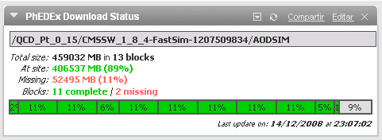
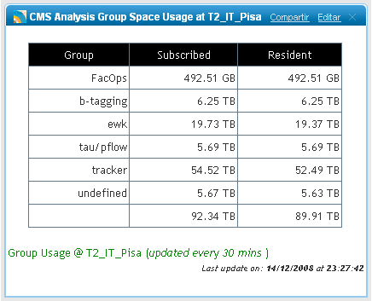
Example widgets: Data Management
- Dataset Download Status -
Shows how much (block, files) of a given dataset are at a site
Uses DBS/PhEDEx web services
We are studying ways of providing a link to a customized widget each time a dataset is approved for transfer
- Group Space Usage -
Visualize the space each physics or detector group is using at a given site
http://tinyurl.com/datasetdownloadstatus
http://farmsmon.pi.infn.it/dcachemon/GroupUsage.html

Slide 22
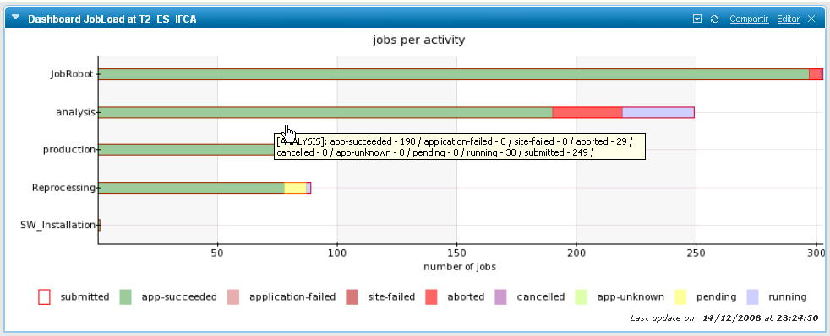
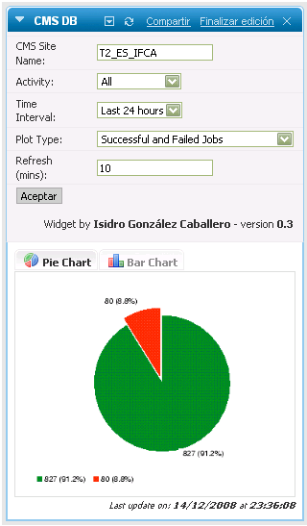
Example widgets: Job load
- Interactive View or Historic View -
Show plot for any activity or for a specific one
Sort by Dataset/Activity/User (interactive)
3 different plots based on error codes (historic)
Pie/Bar Chart (historic)
Interactive: http://tinyurl.com/interactivejobload
Historic: http://tinyurl.com/historicaljobload

Slide 23
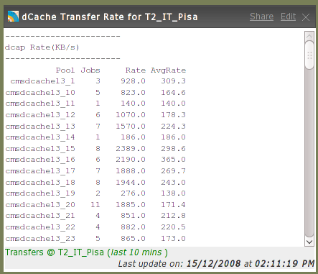
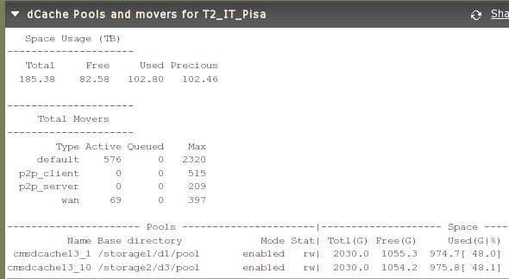
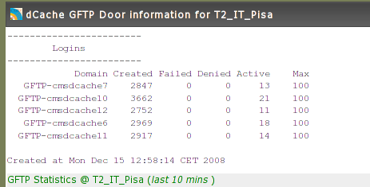
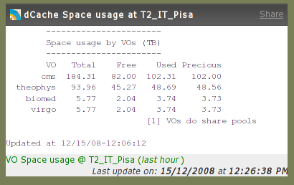
Example widgets: dCache monitoring
Built to monitor a local service (dCache) in a site
May be used by:
  Other dCache sites
  To customize private monitoring pages
Includes:
  dCache pools
  Internal transfer rates
  Door information
  Local space monitoring

Slide 24
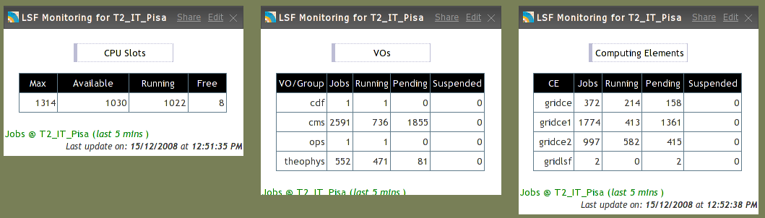
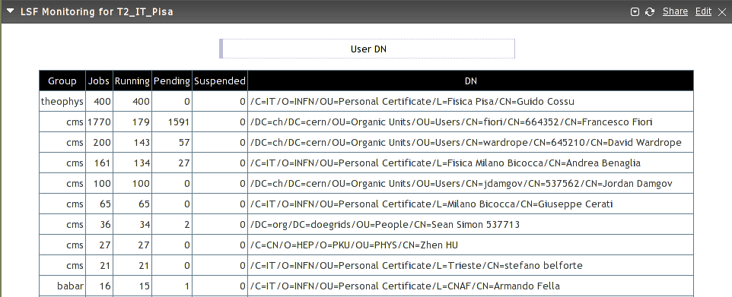
Example widgets: Local batch system

Slide 25
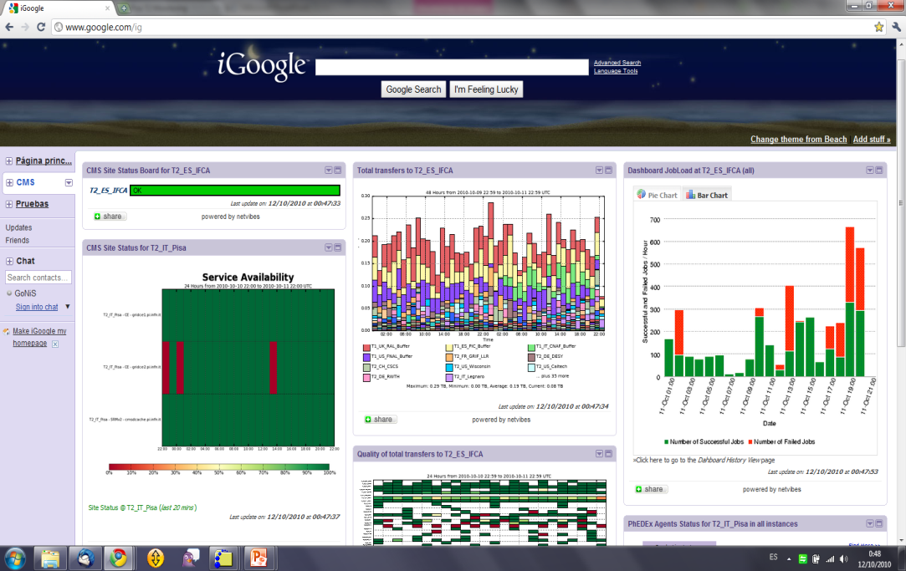
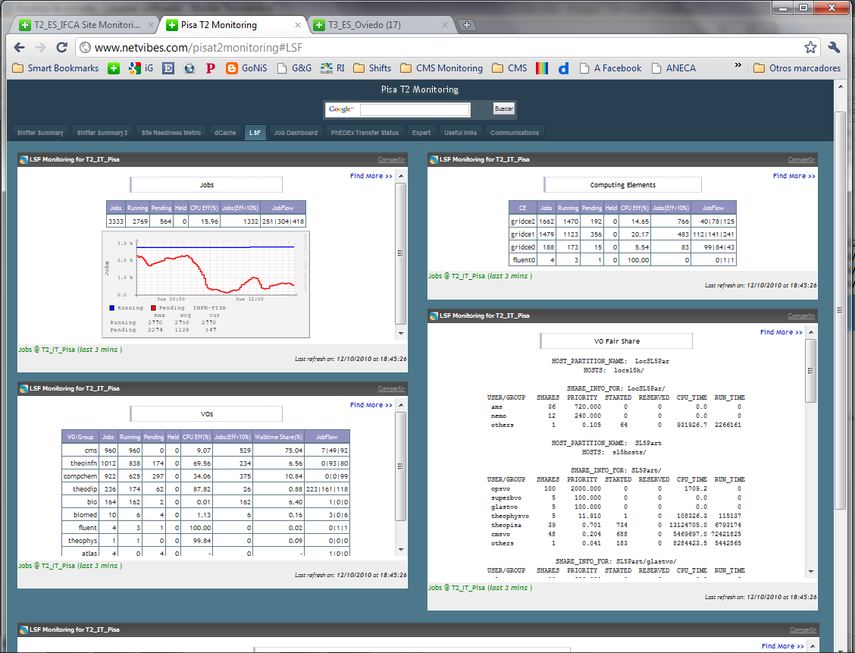
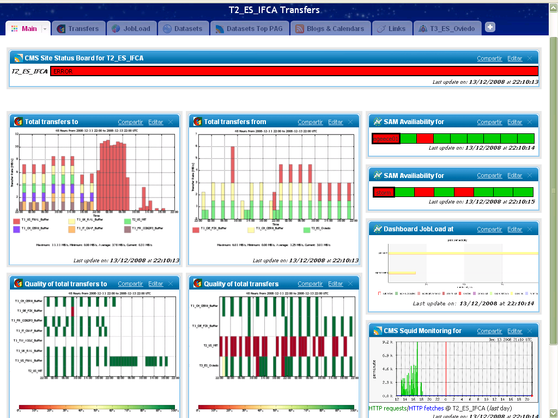
Examples: Agregated in web portals

Slide 26
Conclusions
The widgets technology provides a different way of visualizing the same monitoring data
  Enabling a great level of personal customization
  Solving the problems coming from having a unique monitoring tool that suits everybody
Widgets based on UWA can be used in a great variety of platforms
  Including the main ones (by number of users) in the market
  All of them with their advantages, tricks and nice fireworks
Developing new widgets is rather easy
  Only a bit of XHTML and JavaScript is required
  Provided there are good web services accessible
  Changes in the API or improvements are quickly propagated to the users
The tools presented here are not to be seen as replacements to the current various dedicated and quite complete monitoring systems out there:
  It should be better though as a orthogonal complement to them
Widgets are being efficiently used to monitor the CMS Computing services

Slide 27
References
CMS
  Twiki for widgets:
  https://twiki.cern.ch/twiki/bin/viewauth/CMS/WidgetsMonitoring
  Widgets Code:
  http://cmssw.cvs.cern.ch/cgi-bin/cmssw.cgi/UserCode/IGonzalez/widgets/
Universal Widget API:
  Documentation
  http://dev.netvibes.com
  Netvibes Ecosystem:
  http://eco.netvibes.com/
Portals:
  Netvibes: http://www.netvibes.com
  iGoogle: http://www.google.com/ig
…

Slide 28
This is the end…
THANK YOU VERY MUCH FOR YOUR ATTENTION
Questions and comments are very welcome

