Slide 1
Machine Learning Applied to Data Certification: Status and Plans
F.Fiori (INFN Florence)
on behalf of the CMS DQM-DC Team

Slide 2
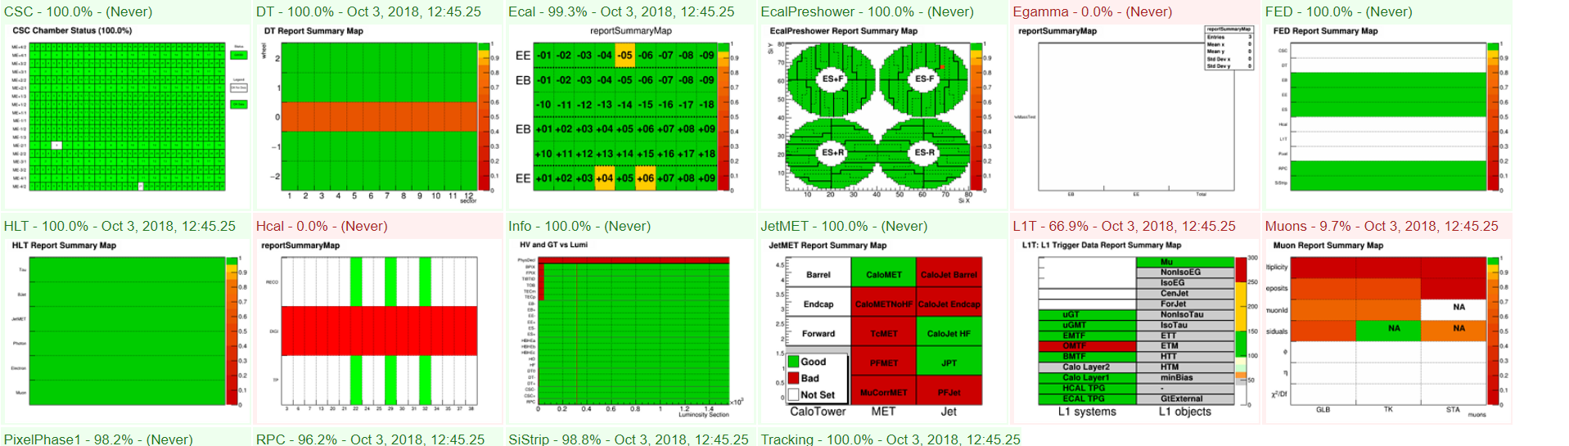
How Data Certification (DC) works?
Trained humans (shifter/experts) inspect a set of DQM plots (~ tenths) for each Subsystem
A binary flag (GOOD or BAD) is assigned with single Run granularity
Flags from each Subsystem are combined (AND) to give a collective flag for the entire Run (GOOD or BAD)
If GOOD, the Run will end up in the Golden JSON file
Single Lumisection granularity from (mostly) DCS bits (see backup)
If BAD data are rejected (less than 5%)
DQM Offline Data per Single Run
manual inspection
(or semi-automated)
Subsystems
AND of quality flags (GOOD or BAD)
DCS
GOOD:To JSON
BAD:Reject

Slide 3
Main reasons to automate the DC process
We have 14 different Subsystems contributing to DC:
L1Tmu, L1TCalo, DT, CSC, Muon, Pixel, Strip, Tracking, ECAL, ES, Egamma, HCAL, JetMET, Lumi (if one is set as BAD the full Run is BAD)
Around 50-70 people involved in the full process!
Additionally, we want to provide DC results with single Lumisection (LS) granularity!
Lumisection ~23 seconds of data taking
In 2017 and 2018, each run contains an average of 500 LS
DQM Offline Data per Single Lumisection
Automated inspection
Subsystems
AND of quality flags (GOOD or BAD)
DCS
GOOD:To JSON
BAD:Reject

Slide 4
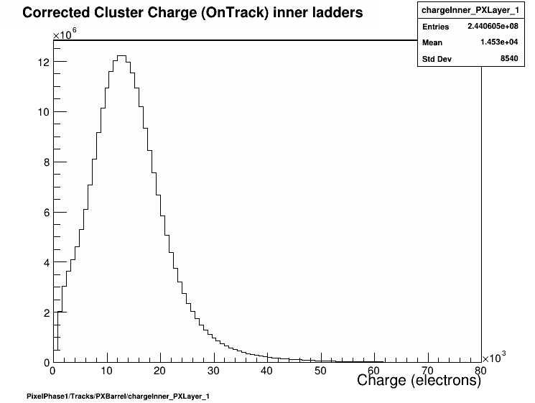
Plan to automate DC using ML
Start automating the “elementary action” in DC: establish quality of single Histograms
Given with single LS time granularity (backup)
Semi-supervised (or Unsupervised) models preferable over Supervised, two main reasons:
The Golden JSON doesn’t provide True Labels on single histograms
The amount of genuine BAD data is very low
Proposed design features:
Keep the model as simple as possible
The same model should generalize well to different types of histograms
The outcome should be human interpretable (for a quick cross check)
Generic Input Histogram
ML Model
Quality Flag

Slide 5
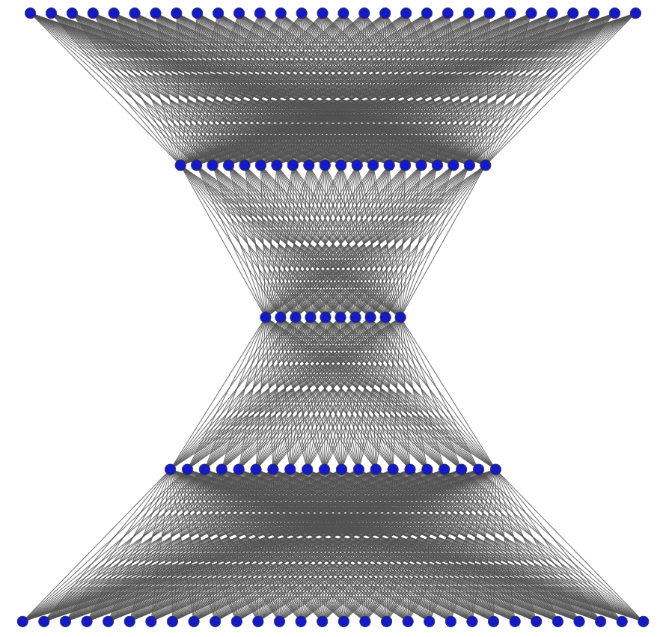
The Autoencoder approach
Train an Autoencoder on GOOD data (Semi-Supervised), use the reconstruction error (MSE) to identify “anomalies”
A model made of 3 hidden layers (20-10-20) seems to be suitable
The very same architecture of hidden layers used for all histograms
Sigmoid as activation function, loss MSEtop10, input histograms normalized (no further standardization)
MSEtop10 = MSE computed only considering the 10 largest differences in bin content
Tests made using the ZeroBias UL2017 DQMIO dataset with per Lumisection saving
~ 500 runs and 250k LS, more details here
# input nodes = # of bins in the histogram
20 nodes
Fully connected
10 nodes
20 nodes
# output nodes = # of bins in the histogram
MSE = 1/N $\sum_{i=1}^{N}{({y_{i}^{in}− y_{i}^{out})2 }_{ }}$

Slide 6
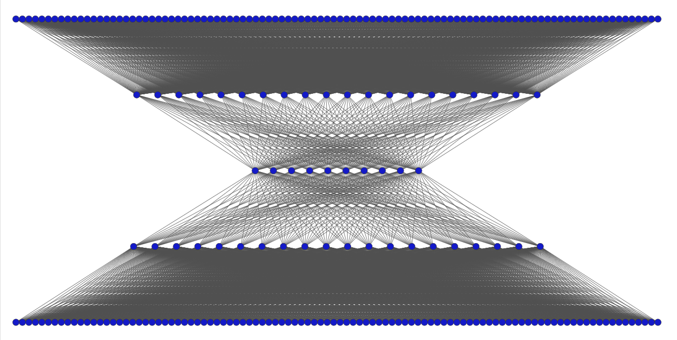
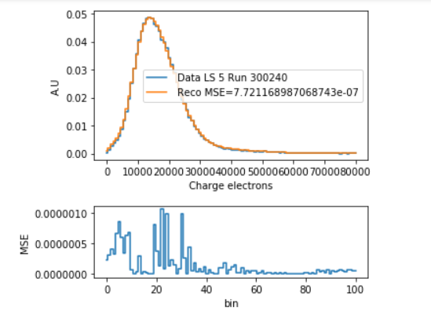
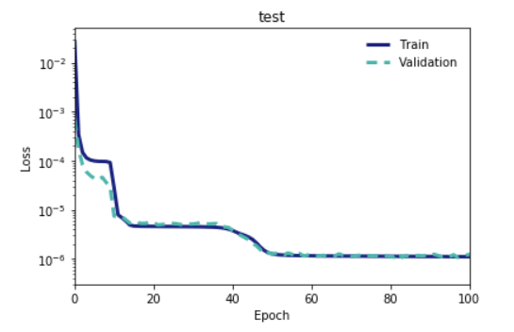
Examples: Pixel Layer1 Inner charge
100 bins in the histogram -> 100 input/output fully connected nodes
20 nodes
Actual model used for this specific histogram
10 nodes
Original Vs Reconstruction
20 nodes
Training on GOLDEN Json
Test on the rest of data
(~ 1 hour to train on CPU)
MSE

Slide 7
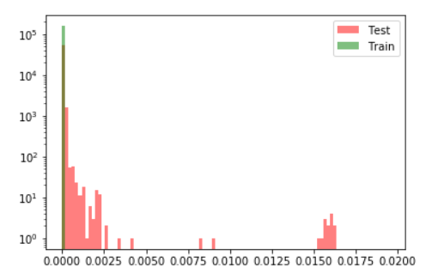
Examples: MSE and Anomalies
Average MSE per run:
Train data: 7.e-7, Test data: 4.e-5
MSE distribution per Lumisection
Training set = Golden JSON data
Test set = all the rest
Notice: The largest part of data not included in JSON (test set in the plot) is actually good for this specific histogram, anomalies are at the few % level

Slide 8
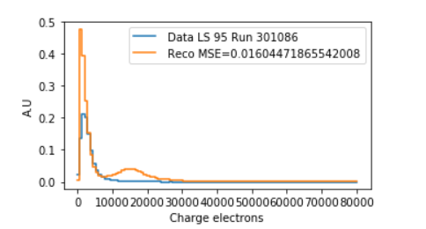
Examples: MSE and Anomalies
Average MSE per run:
Train data: 7.e-7, Test data: 4.e-5
All of this type, corresponding to extreme points in timing or bias scans
MSE distribution per Lumisection
Let’s have a look to anomalies!

Slide 9
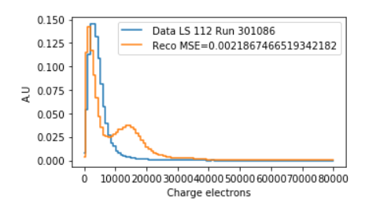
Examples: MSE and Anomalies
Average MSE per run:
Train data: 7.e-7, Test data: 4.e-5
All of this type, corresponding to extreme points in timing or bias scans
MSE distribution per Lumisection
Again too low charge value
Let’s have a look to anomalies!

Slide 10
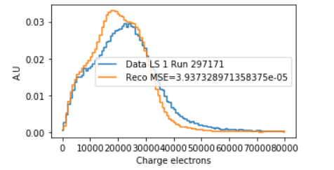
Examples: MSE and Anomalies
Average MSE per run:
Train data: 7.e-7, Test data: 4.e-5
MSE in [1.e-5,1.e-3]
Shape distortions
All of this type, corresponding to extreme points in timing or bias scans
MSE distribution per Lumisection
Again too low charge value
Let’s have a look to anomalies!

Slide 11
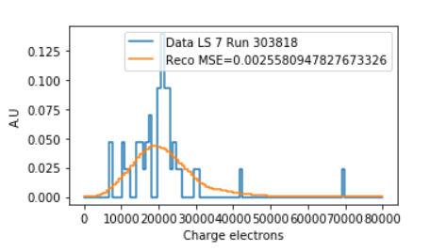
Examples: MSE and Anomalies
Average MSE per run:
Train data: 7.e-7, Test data: 4.e-5
MSE in [1.e-5,1.e-3]
Shape distortions
All of this type, corresponding to extreme points in timing or bias scans
MSE distribution per Lumisection
Again too low charge value
In these region also low stat plots contribute (can be mitigated, see backup)
Let’s have a look to anomalies!

Slide 12
Examples: MSE and Anomalies
Average MSE per run:
Train data: 7.e-7, Test data: 4.e-5
MSE in [1.e-5,1.e-3]
Shape distortions
All of this type, corresponding to extreme points in timing or bias scans
Several different histograms have been inspected with the same workflow, showing the effectiveness of the Autoencoder model to spot anomalies:
Pixel Cluster Charge (Inner/Outer) Layer 1-4
Pixel Charge in Disks (-3 to +3)
Pixel Size (all Layers and Disks)
SiStrip Residuals
# Rec-hits per Track (see backup)
P. Palit, R. Uniyal
MSE distribution per Lumisection
Again too low charge value
In these region also low stat plots contribute (can be mitigated, see backup)
Let’s have a look to anomalies!

Slide 13
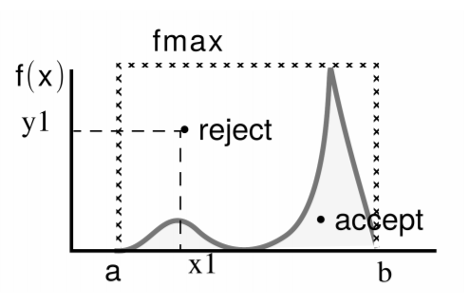
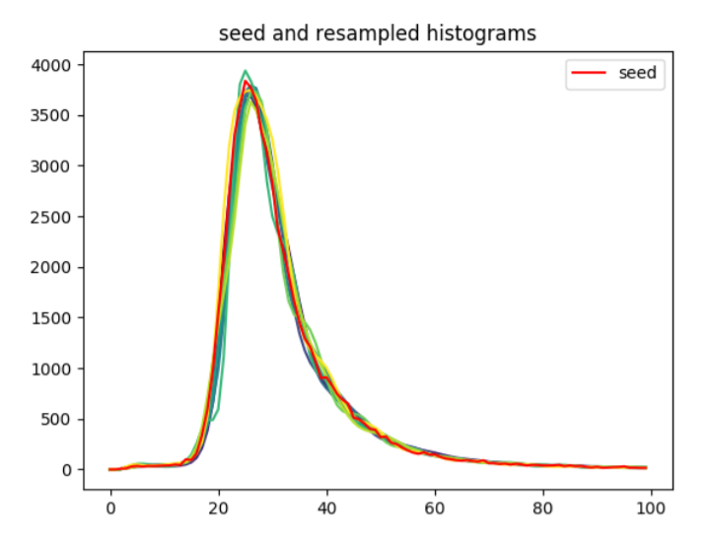
How to quantify performances?
L. Lambrecht, M. Niedziela
Tricky to assess performance without true labels
BAD histograms are too few to quantify performance (and should be selected manually)
Strategy: generate a suitable amount of GOOD and BAD data for validation
A tool is recently available for labelled data generation (talk here)
Can resample a given distribution (MC method)
Can compute random linear combinations of a given set of histograms
Can add noise on top of each bin
Currently under test
Original and resampled distributions

Slide 14
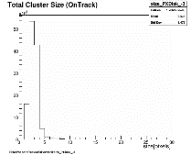
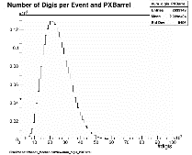
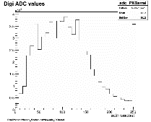
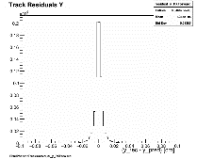
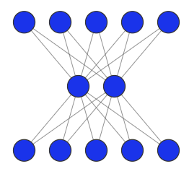
Next step: histogram combination
Single histograms flags have to be combined to give the final flag for the given subsytem
Linear way: different possibilities
Define a MSE threshold for each histogram and combine with a simple AND
Compute a average MSE and set a threshold
Possible also to assign weights to specific histograms (need of subsytems expertise!)
ML way: use of NN on the sample of MSEs
Plan to prototype a model using UL2017 and a restricted set of histograms, test on UL2018
Room for new contributors!
Histo 1
Histo 2
Histo 3
Histo N
ML 1
ML 2
ML 3
ML N
MSE 1
MSE 2
MSE 3
MSE N
Combination Layer
GOOD
BAD

Slide 15
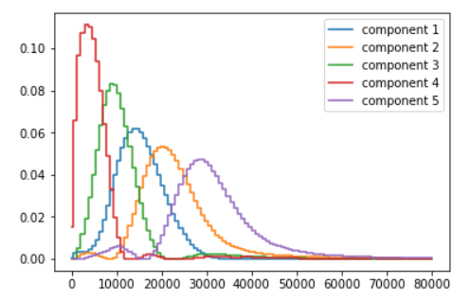
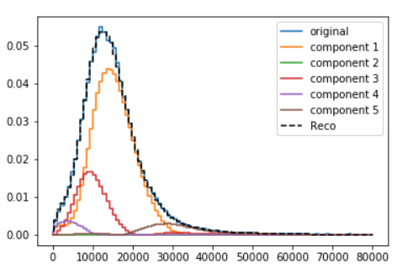
Different open possibilities
NMF: 5 components
Use of Unsupervised models for dimensionality reduction
Commonly used methods (see backup):
Principal Component Analysis (PCA)
Non Negative Matrix Factorization (NMF)
Represent data in a “base” of components:
regular data are well reconstructed using only the first few components
anomalous data show higher order terms
Can be used in combination with the Autoencoder (improve robustness)
Room for new contributors!
Each component is an histogram with the same # of bins as the original
Example reconstruction with NMF

Slide 16
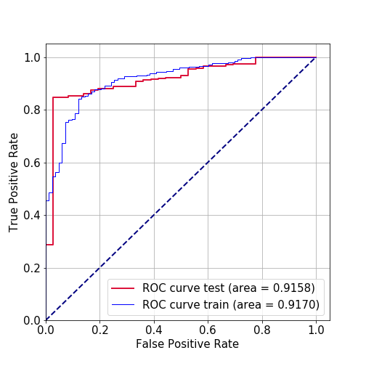
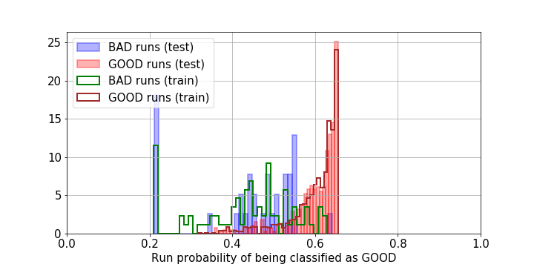
Automate DC per single Run
J. Fernandez, A. Trapote
There are (rare) cases in which a full Run is BAD due to outstanding issues
i.e part of the detector not turned on properly
No need for a detailed LS analysis
Plan to use ML to filter out these trivial cases before applying the DC per single LS
Make use of “standard” DQM GUI files with single run granularity
Histograms moments available in csv files (details here)
Preliminary studies ongoing using Random Forest and Muon data
Possible to use Cosmic runs also
Room for new contributors!
Preliminary
Preliminary

Slide 17
Documentation, code, datasets and meeting
The ML4DQM-DC twiki is the main source of information
Some example code to read data, perform an exploratory analysis (see backup) and run few standard ML models (AE, PCA, NMF) is available here https://github.com/cms-DQM/ML4DQM-DC_SharedTools
Code can be used on SWAN or using GPUs in the IBM Minsky Cluster
Several datasets with Per Lumisection saving are available on disk
Available PDs: UL2017: ZeroBias ,UL2018: ZeroBias, JetMet, SingleMuon, EGamma
Talks and discussion about ML4DQM-DC topics are hosted in the DQM General meeting on Fridays 14h-16h (https://indico.cern.ch/category/3904/)
DQM task twiki: https://twiki.cern.ch/twiki/bin/viewauth/CMS/PPDOpenTasksDQMDC
Generous EPR reward! Please have a look and contact us if interested!
Please, do not hesitate to join our meetings, or contact us! (cms-ml4dqm, cms-ml4dc, ml4dqm-dc.slack.com

Slide 18
Summary and Conclusions
We are on the way to develop ML tools to automate the DC process
The bottom-up approach of using ML on single histograms is promising
Results are human-interpretable, ML models can be kept simple, adding/removing variables is easy
Room for new ideas and contributors!
A small group of contributors is (enthusiastically) gaining experience in ML and on the full DC process
We need this kind of people for a future deployment in production
Huge amount of data available, not manageable by the DQM alone
To subsytems involved in DC: please join this effort, your contribute is fundamental to succeed! (... and save your EPRs ☺ )
Looking forward to interact with the newly created CMS ML group!

Slide 19
Backup

Slide 20
The DCS Bit
DCS = Detector Control System, the DCS bit tells us if a detector is fully operational in the given LS. There is one DCS bit for each DAQ partition (which in general does not correspond to a full CMS sub-detector!), again a simple AND logic is used to give the collective value for the full CMS detector
We have 23 DAQ partitions associated to DCS bits:
bpix, fpix, tibtid, tecm, tecp, tob, ebm, ebp, eem, eep, esm, esp, hbhea, hbheb, hbhec, hf, ho, dtm, dtp, dt0, cscm, cscp, rpc (if any is “0” the LS is BAD)
NOTE: this step is already automated, but not based on any actual control of the quality of data

Slide 21
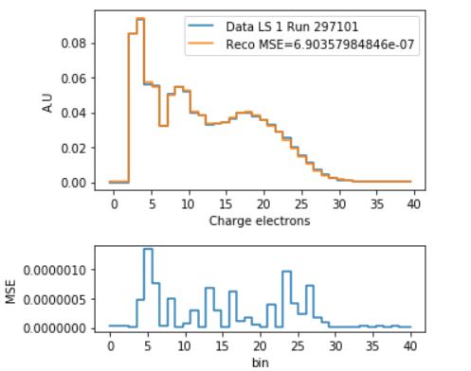
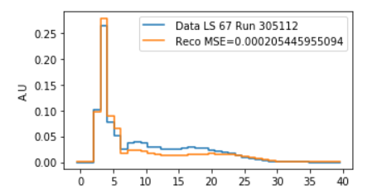
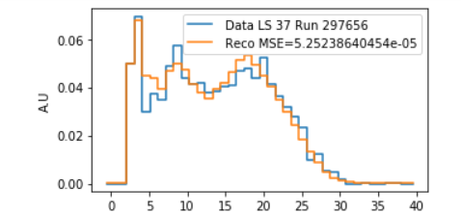
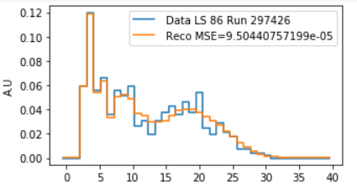
Examples: Application to a different histogram
Very same architecture of hidden layer, in/out layer reflecting the different binning (40 in this case)
Example of Good Histogram
Anomalies
Very few or no Strip hits
Number of hits
Anomalous shape

Slide 22
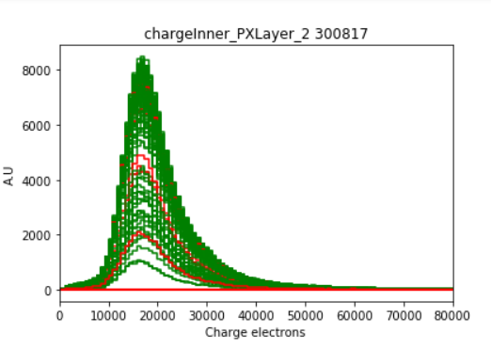
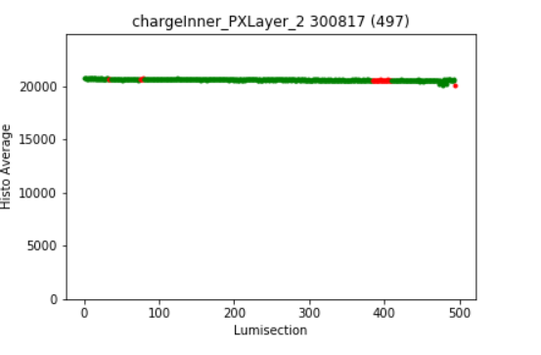
Common code for exploratory analysis
JSON plots: curve (or points) in red belongs to data not included in the Golden JSON, while green plots (or points) represent Golden data
Powerful plots to have a quick analysis of input data, the code to produce such plots is available in the notebook below:
https://github.com/cms-DQM/ML4DQM-DC_SharedTools/blob/master/ML_Model_Examples/Standard_AE_Step-by-Step.ipynb

Slide 23
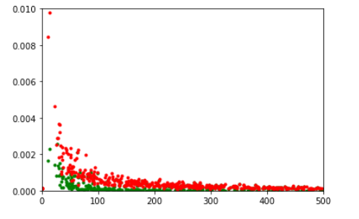
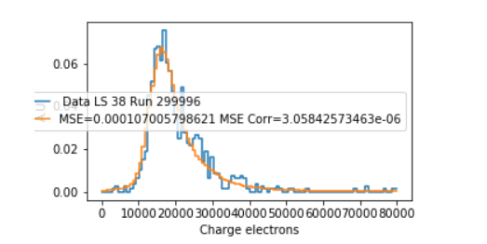
How to treat low statistics histograms
If the statistics is really low, there is no point to attempt any recovery
Some cases are more borderline (see bottom plot), and should be recovered
Strategy: exclude from the MSE bins in which the reconstruction error is inside the statistical error
As a consequence the MSE is, on average, reduced for low stat histograms
MSE
Before mitigation
After mitigation
number of entries
Example of recovered data

Slide 24
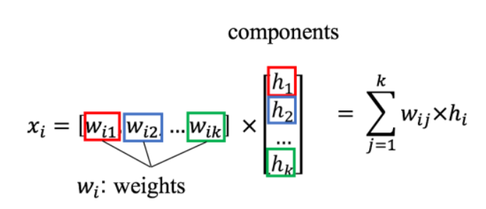
ML models under study: NMF factorization
Non-negative Matrix Factorization (NMF), unsupervised clustering
Deal only with non negative values (i.e histogram frequencies), fast
Given the matrix X of input data, the model compute an approximate decomposition in W·H
each row (i.e histograms) can be approximated by a linear combination of a predefined set of components
Input histogram
NMF with 5 components
components are histograms with the same bin number as the input
(human interpretable)
In principle, could distinguish standard and anomalous data by the values of weights for the different components
Can also be used for 2D plots (image decomposition)!

Slide 25
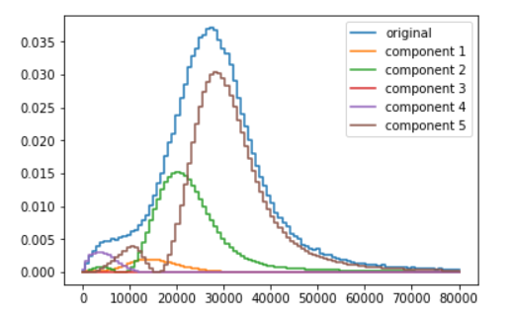
ML models under study: NMF factorization (II)
Preliminary study on the same Pixel Layer1 charge histogram and 2017 data, using 5 components
Input matrix (100x200k), ~ 1 minute to obtain coefficients on Swan
Again, quite a lot of optimization work is needed, however it looks promising ...
standard histo:
main component 1 and 2
Anomalous histo:
main component 5 and 2

Slide 26
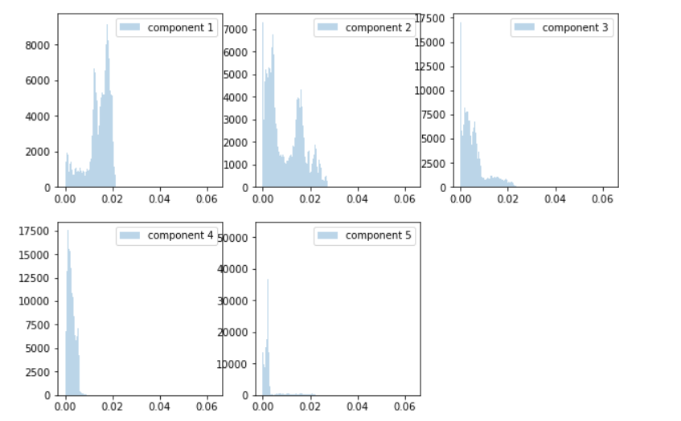
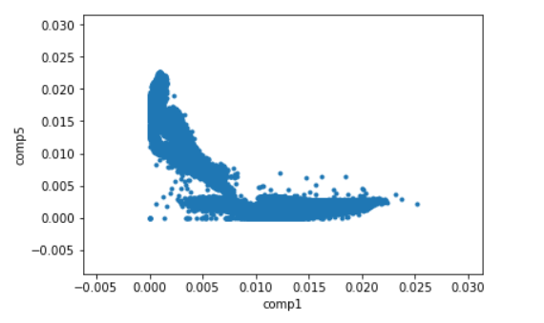
ML models under study: NMF factorization (III)
Classify data based on the contribution of the different components, and undertand which are the cases in which the anomaly traduces to a BAD flag

